Slide 1
5G note
1. Fundamentals of wireless communication
2. Probability and random processes
3. Digital signal processing

Slide 2
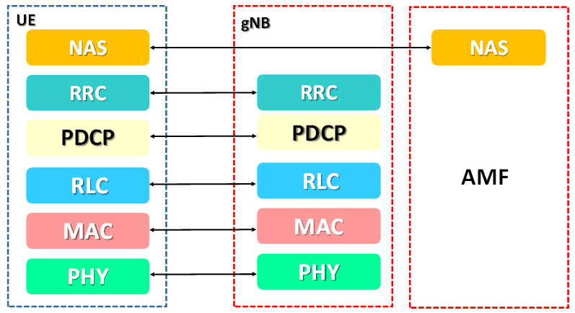
5G NR Protocol stack
Layer 3
Layer 2
Layer 1

Slide 3
5G NR Transceivers
MIMO Channels
Tx
Rx
.
.
.
.
.
.
Beamforming
Mass MIMO

Slide 4
Modulation Techniques
Analog modulation
Linear
Angle
Pulse
Digital modulation
DM, ADM, PCM
PSK, QAM ,MSK

Slide 5
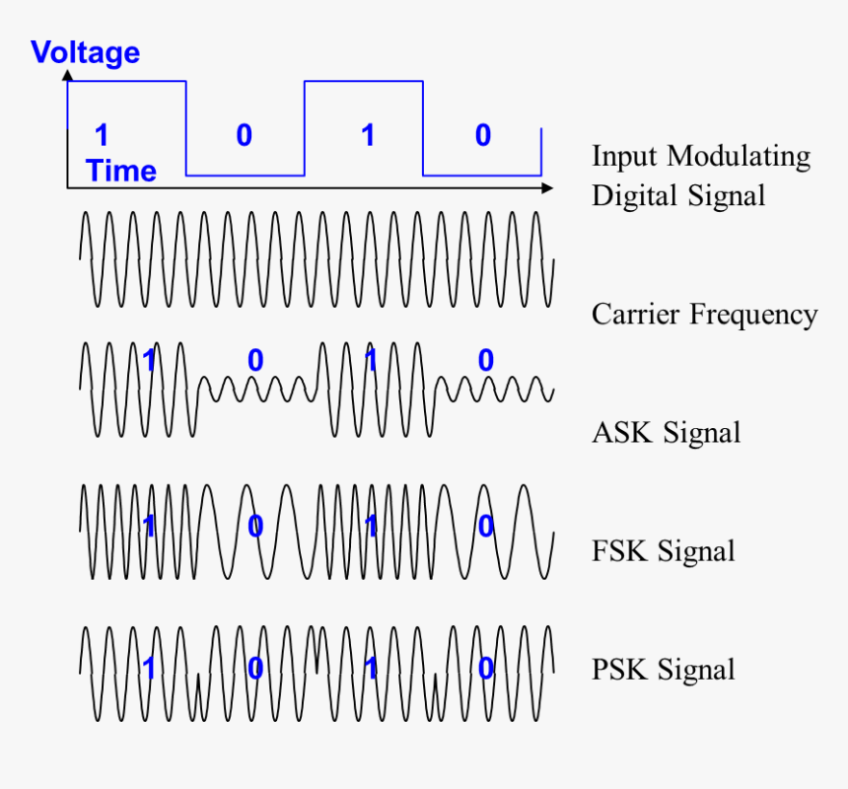
Digital Modulation
ASK, FSK, PSK
Notes:
https://www.electrical4u.com/quadrature-amplitude-modulation-qam/

Slide 6
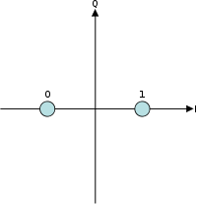
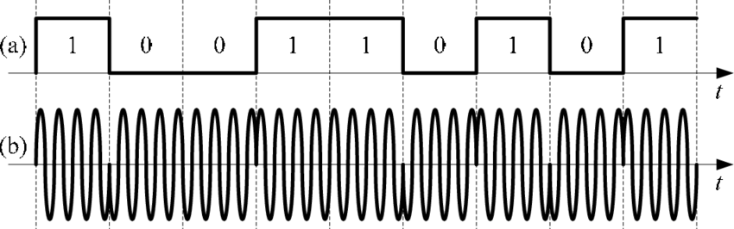
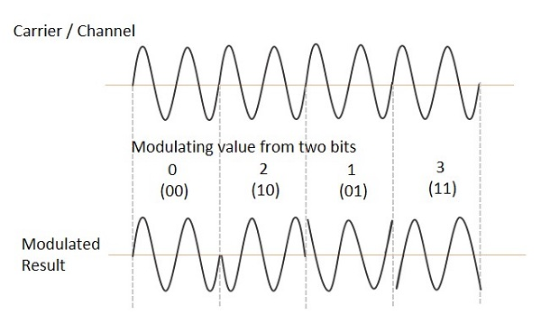
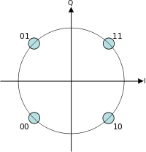
BPSK
QPSK
O-QPSK
MSK

Slide 7
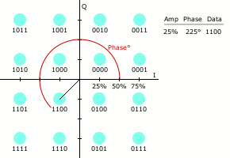
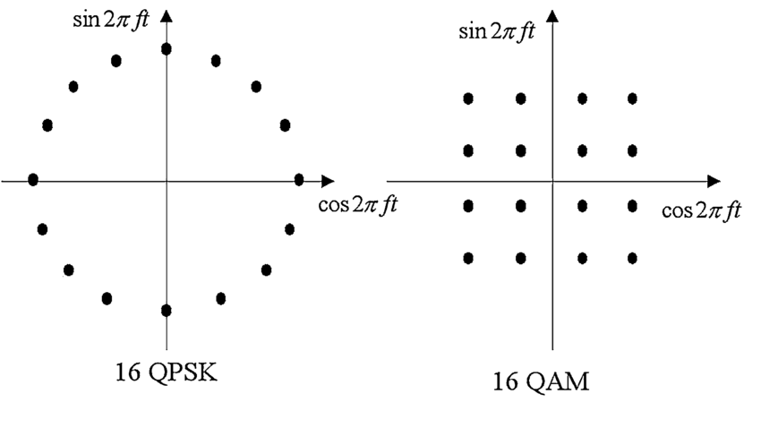
QAM = Amplitude + Phase Modulation

Slide 8
Modulation Coding Scheme(MCS)
MCS = modulation coding scheme and Modulation Order (Modulation depth， QPSK，16QAM，64QAM，256QAM)
Notes:
https://blog.csdn.net/milkbusy/article/details/80931740
https://www.techplayon.com/5g-nr-modulation-and-coding-scheme-modulation-and-code-rate/

Slide 9
ISI(Inter-symbol interference) Effect

Slide 10
Frequency Division Multiplexing(FDM)

Slide 11
Quadrature Multiplexing(QM)

Slide 12
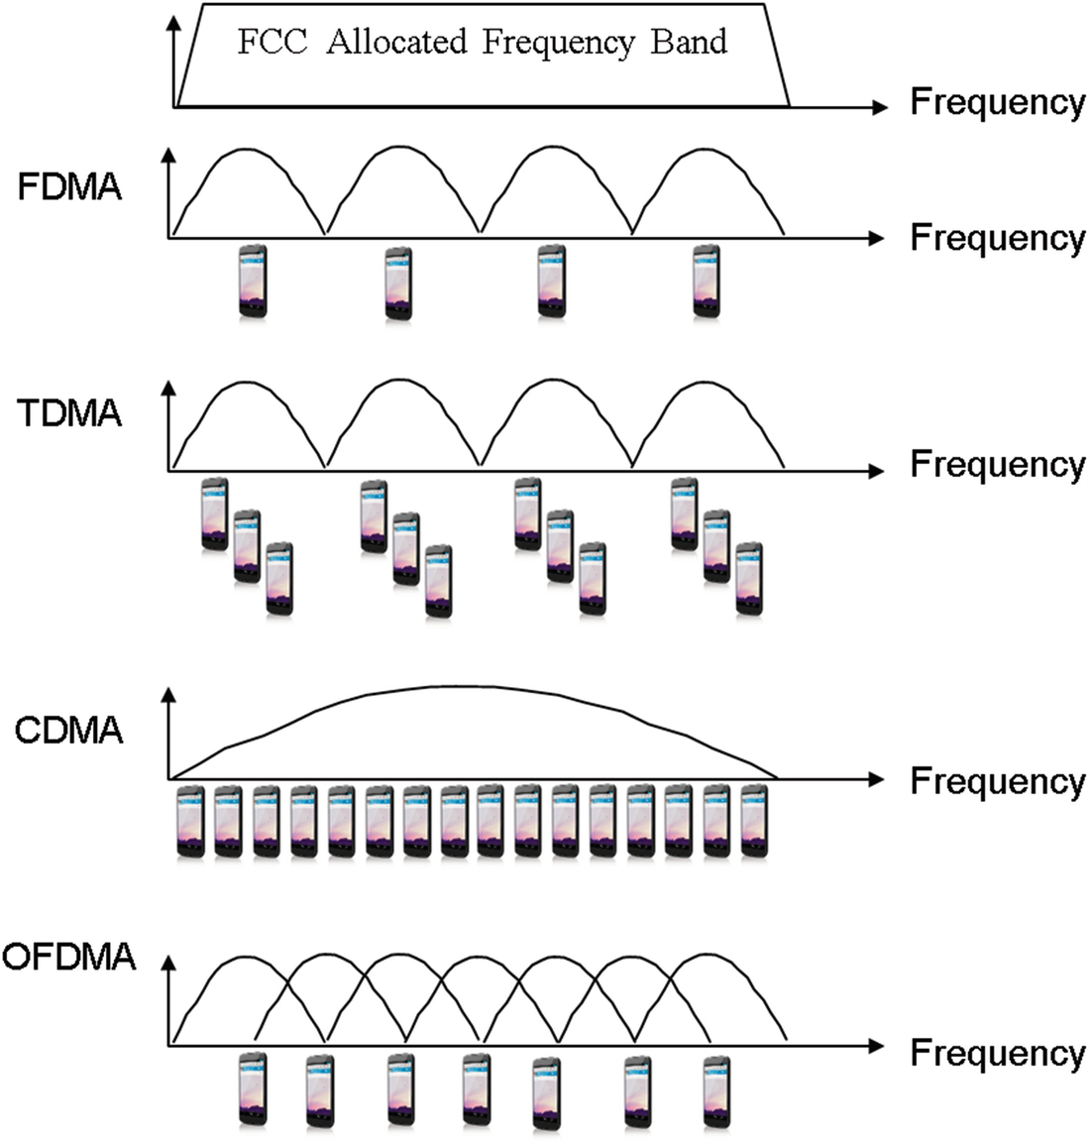
Multiple Access Techniques
TDMA
CDMA => 3G
OFDMA => 4G LTE

Slide 13
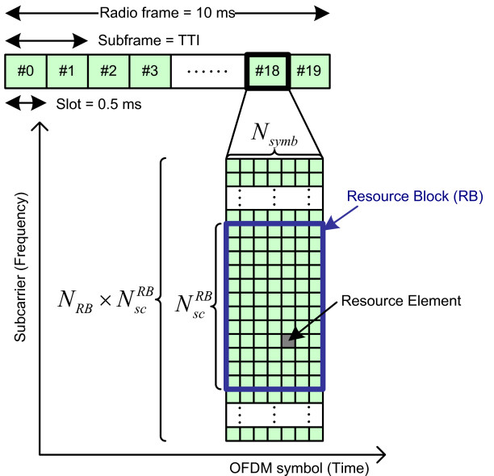
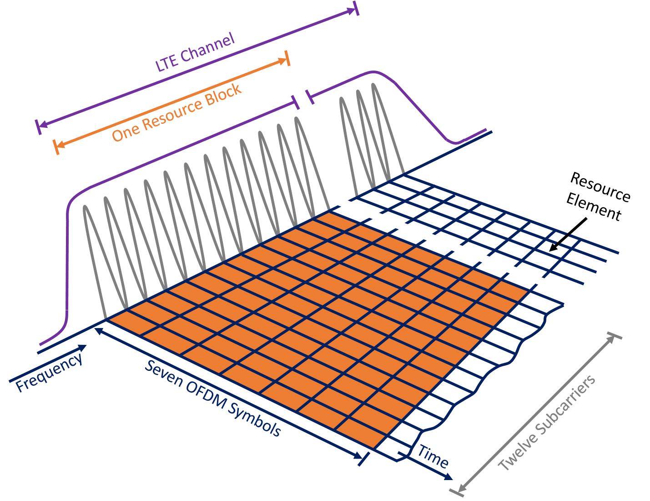
Notes:
https://5g.systemsapproach.org/primer.html

Slide 14
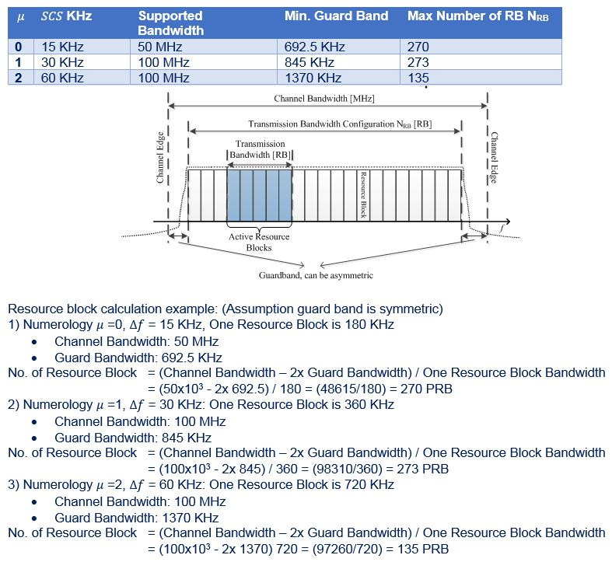
Notes:
https://www.sciencedirect.com/topics/computer-science/physical-resource-block
https://www.etsi.org/deliver/etsi_ts/138100_138199/13810101/15.02.00_60/ts_13810101v150200p.pdf
https://www.techplayon.com/nr-resource-block-definition-and-rbs-calculation/

Slide 15
Wireless Channels

Slide 16
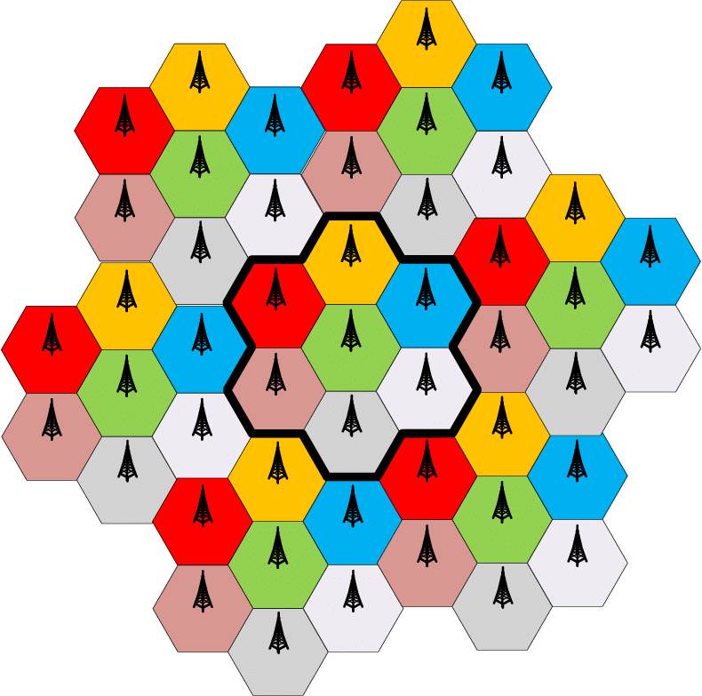
Frequency reuse

Slide 17
Sector antenna

Slide 18
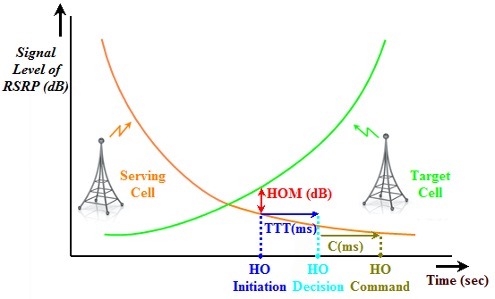
Handoff
Notes:
https://www.netmanias.com/en/post/techdocs/6224/emm-handover-lte/emm-procedure-6-handover-without-tau-part-1-overview-of-lte-handover

Slide 19
5G & FPGA

